Slide 1


Trees
Lecture 12-2

Slide 2

Tree abstraction
Binary tree
A data structure consisting of labeled nodes and edges
Each node has at most 2 children, and at most 1 parent
One node has no parent. It’s called the root
Nodes with no children are called leaves (or terminal)
All the other nodes are called branches (or interim)
root
branch
7
4
2
leaf
5
3
Notes
A binary tree is a recursive data structure:
The children of each node are themselves binary trees
To process trees, we use recursive algorithms.
Depth First Search algorithm (DFS)
// Prints the leaves, left to right
print(node):
if node.isLeaf
print(node)
else
print(node.left)
print(node.right)
Tree processing example
Print all the leaves, left to right.
output:
5 3 7 4 2

Slide 3
Tree implementation
root
data
left
right
root
7
null
null
7
4
2
3
null
null
5
null
null
5
3
Abstraction
Implementation (different tree)
Connected Node objects

Slide 4
Tree implementation
public class Node {
int data;
Node left, right;
// Constructs a branch node
Node(int data, Node left, Node right) {
this.data = data;
this.left = left; this.right = right;
}
// Constructs a leaf node
Node(int data) {
this.data = data;
this.left = null; this.right = null;
}
// Checks if this node is a leaf node
boolean isLeaf() {
return ((left == null) &&
(right == null));
}
// Prints all the leaves below this node, L to R
public void print() {
if (isLeaf()) {
System.out.print(data + " ");
} else {
left.print();
right.print();
}
}
}
data
left
right
root
7
null
null
3
null
null
5
null
null
Client code:
// Constructs the above tree
Node leaf1 = new Node(7);
Node leaf2 = new Node(3);
Node leaf3 = new Node(5);
Node branch = new Node(0, leaf2, leaf3);
Node root = new Node(0, leaf1, branch);
root.print();
output:
7 3 5

Slide 5
Tree implementation
public class Node {
int data;
Node left, right;
// Constructs a branch node
Node(int data, Node left, Node right) {
this.data = data;
this.left = left; this.right = right;
}
// Constructs a leaf node
Node(int data) {
this.data = data;
this.left = null; this.right = null;
}
// Checks if this node is a leaf node
boolean isLeaf() {
return ((left == null) &&
(right == null));
}
// Prints all the leaves below this node, L to R
public void print() {
if (isLeaf()) {
System.out.print(data + " ");
} else {
left.print();
right.print();
}
}
}
Next
We will now turn to describe an elegant and important application that uses trees:
Compression

Slide 6
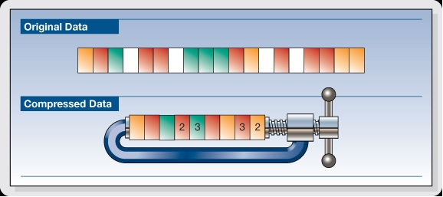
Compression
Lecture 12-2

Slide 7
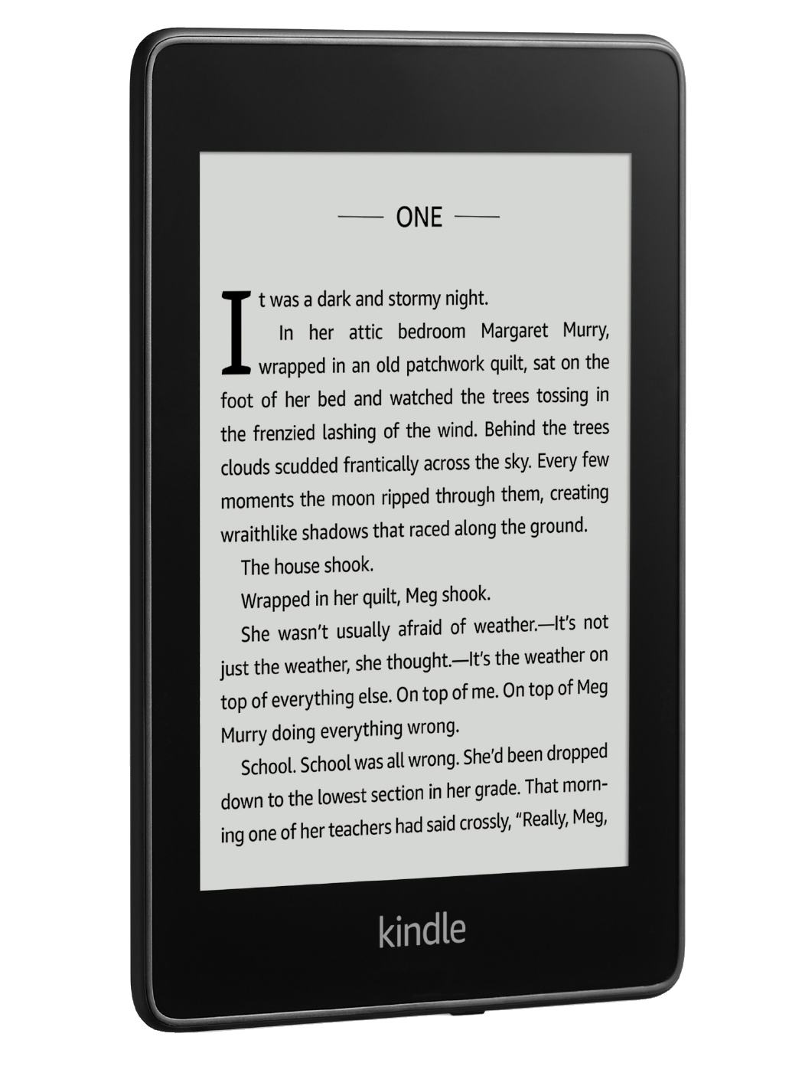


Data explosion
text
video
audio
Every day, 10¹⁹ new bits are added to the Internet
Goals
Minimize storage space
Minimize download / upload time
Compression algorithms
Lossless (ZIP, PNG, …)
Lossy (JPG, MPEG, MP3, …)

Slide 8
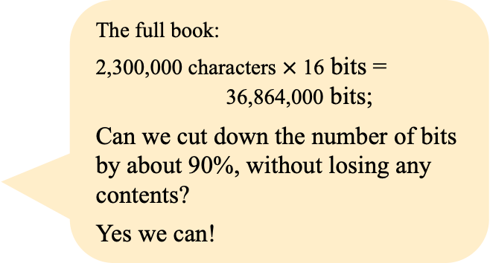
Data explosion
Example (A Promised Land, by Barack Obama, 738 pages)
… I began writing this book shortly after the end of my presidency—after Michelle and I had boarded Air Force One for the last time and traveled west for a long-deferred break. The mood on the plane was bittersweet. Both of us were drained, physically and emotionally, not only by the labors of the previous eight years but by the unexpected results of an election in which someone diametrically opposed to everything we stood for had been chosen as my successor. Still, having run our leg of the race to completion, we took satisfaction in knowing that we’d done our very best—and that however much I’d fallen short as president, whatever projects I’d hoped but failed to accomplish, the country was in better shape now than it had been when I’d started. For a month, Michelle and I slept late, ate leisurely dinners, went for long walks, swam in the ocean, took stock, replenished our friendship, rediscovered our love, and planned for a less eventful but hopefully no less satisfying second act. …
The full book:
2,300,000 characters $×$ 16 bits = 36,864,000 bits;
Can we cut down the number of bits by about 90%, without losing any contents?
Yes we can!

Slide 9
Lecture plan
Trees
Compression: Algorithms
Compression: Implementation
Compression: Extensions

Slide 10
Character frequency
Example (this paragraph only)
frequencies
… I began writing this book shortly after the end of my presidency—after Michelle and I had boarded Air Force One for the last time and traveled west for a long-deferred break. The mood on the plane was bittersweet. Both of us were drained, physically and emotionally, not only by the labors of the previous eight years but by the unexpected results of an election in which someone diametrically opposed to everything we stood for had been chosen as my successor. Still, having run our leg of the race to completion, we took satisfaction in knowing that we’d done our very best—and that however much I’d fallen short as president, whatever projects I’d hoped but failed to accomplish, the country was in better shape now than it had been when I’d started. For a month, Michelle and I slept late, ate leisurely dinners, went for long walks, swam in the ocean, took stock, replenished our friendship, rediscovered our love, and planned for a less eventful but hopefully no less satisfying second act. …
0
text
analysis
...
'a'
54
'b'
16
'c'
25
'd'
39
'e'
107
'f'
22
'g'
10
'h'
40
...
255

Slide 11
Character frequency
Example (small data, for testing)
frequencies
0
// Builds a frequencies array, for testing
double[] freq = new double[256];
freq['a'] = 8; freq['b'] = 3;
freq['c'] = 1; freq['d'] = 1; freq['e'] = 1;
freq['f'] = 1; freq['g'] = 1; freq['h'] = 1;
text
analysis
...
'a'
8
'b'
3
'c'
1
'd'
1
'e'
1
'f'
1
'g'
1
'h'
1
...
255
Reminder: char values are numbers, e.g. 'a' = 97 and 'h' = 104
(Example adapted from Structure and Interpretation of Computer Programs by Abelson and Sussman, MIT Press)

Slide 12
Building a Huffman tree
Example (small data, for testing)
frequencies
0
// Builds a frequencies array, for testing
double[] freq = new double[256];
freq['a'] = 8; freq['b'] = 3;
freq['c'] = 1; freq['d'] = 1; freq['e'] = 1;
freq['f'] = 1; freq['g'] = 1; freq['h'] = 1;
text
analysis
...
'a'
8
'b'
3
'c'
1
'd'
1
'e'
1
'f'
1
'g'
1
'h'
1
...
255
First step in building a Huffman tree:
Reminder: char values are numbers, e.g. 'a' = 97 and 'h' = 104
Construct a list from the frequencies array:
a , 8
b , 3
c , 1
d , 1
e , 1
f , 1
g , 1
h , 1

Slide 13
Building a Huffman tree
Construct a list from the frequencies array:
a , 8
b , 3
c , 1
d , 1
e , 1
f , 1
g , 1
h , 1
Remove the first two nodes that have minimal frequencies, combine them, and add the combined node to the list:
a , 8
b , 3
e , 1
f , 1
g , 1
h , 1
cd , 2
c , 1
d , 1
Again:
a , 8
b , 3
g , 1
h , 1
cd , 2
ef , 2
c , 1
d , 1
e , 1
f , 1
Again:

Slide 14
Building a Huffman tree
Continue from previous slide:
a , 8
b , 3
cd , 2
ef , 2
gh , 2
c , 1
d , 1
e , 1
f , 1
g , 1
h , 1
Again:
a , 8
b , 3
gh , 2
cdef , 4
g , 1
h , 1
cd , 2
ef , 2
c , 1
d , 1
e , 1
f , 1
Again:
a , 8
cdef , 4
ghb , 5
cd , 2
ef , 2
gh , 2
b , 3
c , 1
d , 1
e , 1
f , 1
g , 1
h , 1
Again:

Slide 15
Building a Huffman tree
Continue from previous slide:
a , 8
cdefghb , 9
cdef , 4
ghb , 5
cd , 2
ef , 2
gh , 2
b , 3
c , 1
d , 1
e , 1
f , 1
g , 1
h , 1
Again:
acdefghb , 17
a , 8
cdefghb , 9
cdef , 4
ghb , 5
cd , 2
ef , 2
gh , 2
b , 3
c , 1
d , 1
e , 1
f , 1
g , 1
h , 1

Slide 16
Building a Huffman tree
Binary Tree:
acdefghb , 17
a , 8
cdefghb , 9
cdef , 4
ghb , 5
cd , 2
ef , 2
gh , 2
b , 3
c , 1
d , 1
e , 1
f , 1
g , 1
h , 1

Slide 17
Huffman codes
a , 8
b , 3
c , 1
d , 1
e , 1
f , 1
g , 1
h , 1

Slide 18
Huffman codes
0
1
a , 8
0
1
0
1
0
1
b , 3
0
0
1
0
1
c , 1
d , 1
e , 1
f , 1
g , 1
h , 1

Slide 19
Huffman codes
0
1
a , 8
0
1
0
1
0
1
b , 3
0
0
1
0
1
c , 1
d , 1
e , 1
f , 1
g , 1
h , 1
code('a') = 0

Slide 20
Huffman codes
0
1
a , 8
0
1
0
1
0
1
b , 3
0
0
1
0
1
c , 1
d , 1
e , 1
f , 1
g , 1
h , 1
code('b') = 111

Slide 21
Huffman codes
0
1
a , 8
0
1
0
1
0
1
b , 3
0
0
1
0
1
c , 1
d , 1
e , 1
f , 1
g , 1
h , 1
code('c') = 1000

Slide 22
Huffman codes
0
1
a , 8
0
1
0
0
1
0
1
b , 3
0
0
1
0
1
111
c , 1
d , 1
e , 1
f , 1
g , 1
h , 1
1000
1001
1010
1011
1100
1101

Slide 23
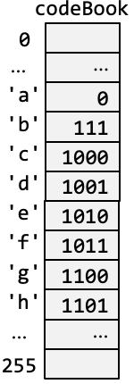
Huffman codes
build
Coding properties
Efficiency: The higher the character frequency, the shorter the code
Prefix free: No code is a prefix of any other code

Slide 24
Compression
"abadcab"

Slide 25
Compression
"abadcab"
0

Slide 26
Compression
"abadcab"
0111

Slide 27
Compression
"abadcab"
01110

Slide 28
Compression
"abadcab"
011101001

Slide 29
Compression
"abadcab"
0111010011000

Slide 30
Compression
"abadcab"
01110100110000

Slide 31
Compression
"abadcab"
01110100110000111

Slide 32
Compression
"abadcab"
01110100110000111

Slide 33

Compression
"abadcab"
01110100110000111
7 * 16 = 112 bits
17 bits
Compressed text: 84% shorter

Slide 34
Decompression
Compressed text:
0
1
01110100110000111
a
0
1
0
1
0
1
b
0
1
0
1
0
1
c
d
e
f
g
h

Slide 35
Decompression
Compressed text:
0
1
01110100110000111
a
0
1
0
1
0
1
b
0
1
0
1
0
1
c
d
e
f
g
h

Slide 36
Decompression
Compressed text:
0
1
01110100110000111
a
"a"
0
1
0
1
0
1
b
0
1
0
1
0
1
c
d
e
f
g
h

Slide 37
Decompression
Compressed text:
0
1
01110100110000111
a
"a"
0
1
0
1
0
1
b
0
1
0
1
0
1
c
d
e
f
g
h

Slide 38
Decompression
Compressed text:
0
1
01110100110000111
a
"a"
0
1
0
1
0
1
b
0
1
0
1
0
1
c
d
e
f
g
h

Slide 39
Decompression
Compressed text:
0
1
01110100110000111
a
"ab"
0
1
0
1
0
1
b
0
1
0
1
0
1
c
d
e
f
g
h

Slide 40
Decompression
Compressed text:
0
1
01110100110000111
a
"ab"
0
1
0
1
0
1
b
0
1
0
1
0
1
c
d
e
f
g
h

Slide 41
Decompression
Compressed text:
0
1
01110100110000111
a
"ab"
0
1
0
1
0
1
b
0
1
0
1
0
1
c
d
e
f
g
h

Slide 42
Decompression
Compressed text:
0
1
01110100110000111
a
"aba"
0
1
0
1
0
1
b
0
1
0
1
0
1
c
d
e
f
g
h

Slide 43
Decompression
Compressed text:
0
1
01110100110000111
a
"aba"
0
1
0
1
0
1
b
0
1
0
1
0
1
c
d
e
f
g
h

Slide 44
Decompression
Compressed text:
0
1
01110100110000111
a
"aba"
0
1
0
1
0
1
b
0
1
0
1
0
1
c
d
e
f
g
h

Slide 45
Decompression
Compressed text:
0
1
01110100110000111
a
"abad"
0
1
0
1
0
1
b
0
1
0
1
0
1
c
d
e
f
g
h

Slide 46
Decompression
Compressed text:
0
1
01110100110000111
a
"abad"
0
1
0
1
0
1
b
0
1
0
1
0
1
c
d
e
f
g
h

Slide 47
Decompression
Compressed text:
0
1
01110100110000111
a
"abad"
0
1
0
1
0
1
b
0
1
0
1
0
1
c
d
e
f
g
h

Slide 48
Decompression
Compressed text:
0
1
01110100110000111
a
"abadc"
0
1
0
1
0
1
b
0
1
0
1
0
1
c
d
e
f
g
h

Slide 49
Decompression
Compressed text:
0
1
01110100110000111
a
"abadc"
0
1
0
1
0
1
b
0
1
0
1
0
1
c
d
e
f
g
h

Slide 50
Decompression
Compressed text:
0
1
01110100110000111
a
"abadc"
0
1
0
1
0
1
b
0
1
0
1
0
1
c
d
e
f
g
h

Slide 51
Decompression
Compressed text:
0
1
01110100110000111
a
"abadca"
0
1
0
1
0
1
b
0
1
0
1
0
1
c
d
e
f
g
h

Slide 52
Decompression
Compressed text:
0
1
01110100110000111
a
"abadca"
0
1
0
1
0
1
b
0
1
0
1
0
1
c
d
e
f
g
h

Slide 53
Decompression
Compressed text:
0
1
01110100110000111
a
"abadca"
0
1
0
1
0
1
b
0
1
0
1
0
1
c
d
e
f
g
h

Slide 54
Decompression
Compressed text:
0
1
01110100110000111
a
"abadcab"
0
1
0
1
0
1
b
0
1
0
1
0
1
c
d
e
f
g
h

Slide 55
Decompression
Compressed text:
0
1
01110100110000111
a
"abadcab"
0
1
0
1
0
1
b
0
1
0
1
0
1
c
d
e
f
g
h

Slide 56
Decompression
Compressed text:
0
1
01110100110000111
a
"abadcab"
0
1
0
1
0
1
b
0
1
0
1
0
1
c
d
e
f
g
h
Observations
Prefix free: No need to separate codes with markers
Lossless: decompress(compress("abadcab")) = "abadcab"

Slide 57
Lecture plan
Trees
Compression: Algorithms
Compression: Implementation
Compression: Extensions

Slide 58
Using compression
/** Provides text compression and decompression methods.
* Before using, the init method must be called. */
public class Comp {
/** Initializes data structures based on the given letter frequencies. */
public static void init(double[] freq)
/** Compresses the given text into a string of 0's and 1's. */
public static String compress(String text)
/** Decompresses the given coded text into the original text. */
public static String decompress(String codedText)
}
// Client code
double[] freq = new double[256];
freq['a'] = 8; freq['b'] = 3; freq['c'] = 1; freq['d'] = 1; freq['e'] = 1; freq['f'] = 1; freq['g'] = 1; freq['h'] = 1;
Comp.init(freq);
String text = "abadcab";
System.out.println("Text: " + text);
String compressedText = Comp.compress(text);
System.out.println("Compressed text: " + compressedText);
System.out.println("Decompressed text: " + Comp.decompress(compressedText));
output
Text: abadcab
Compressed text: 01110100110000111
Decompressed text: abadcab
lossless

Slide 59
Behing the scene”: Huffman Tree
0
1
a , 8
0
1
0
1
0
1
b , 3
0
0
1
0
1
c , 1
d , 1
e , 1
f , 1
g , 1
h , 1

Slide 60
Tree implementation = connected Node objects
Node objects
0
1
a
8
0
1
0
1
0
1
b
3
0
1
0
1
0
1
c
1
d
1
e
1
f
1
g
1
h
1

Slide 61
Node class
/** Represents a node in a Huffman tree. */
public class Node {
char ch; // character
double freq; // character's frequency
Node left, right; // pointers to child nodes
/** Constructs a branch (interim) node */
Node(char ch, double freq, Node left, Node right) {
this.ch = ch; this.freq = freq;
this.left = left; this.right = right;
}
/** Constructs a leaf (terminal) node */
Node(char ch, double freq) {
this.ch = ch; this.freq = freq;
this.left = null; this.right = null;
}
/** Checks if this node is a leaf node */
boolean isLeaf() {
return ((left == null) && (right == null));
}
/** Prints the leaves below this node, L to R (for testing) */
// Algorithm: Depth First Search (DFS) tree traversal
public void print() {
if (isLeaf()) {
System.out.println(ch + ": " + freq);
} else {
left.print();
right.print();
}
}
}
root
ch
freq
left
right
15
ch
freq
left
right
ch
freq
left
right
e
13
null
null
k
2
null
null
Tree implementation:
connected Node objects

Slide 62
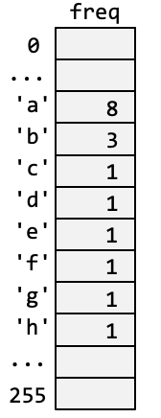
Compression class: Building the code book
import java.util.LinkedList;
public class Comp {
static Node root; // top node
static String[] codeBook; // array of character codes
/** Initializes data structures, based on the given letter frequencies. */
public static void init(double[] freq) {
// Sets root to the Huffman tree
root = buildTree(freq);
// Builds and populates the code book
codeBook = new String[freq.length];
populateCodeBook(root, "", codeBook);
}
...

Slide 63
Compression class: Building the code book
import java.util.LinkedList;
public class Comp {
static Node root; // top node
static String[] codeBook; // array of character codes
/** Initializes data structures, based on the given letter frequencies. */
public static void init(double[] freq) {
// Sets root to the Huffman tree
root = buildTree(freq);
// Builds and populates the code book
codeBook = new String[freq.length];
populateCodeBook(root, "", codeBook);
}
// Returns a Huffman tree, built from the given letter frequencies. */
private static Node buildTree(double[] freq) {
// Builds the initial, flat tree (list of Node elements)
LinkedList<Node> tree = new LinkedList<>();
// If a letter frequency is greater than 0, adds a new node
for (char ch = 0; ch < freq.length; ch++) {
if (freq[ch] > 0) {
tree.add(new Node(ch, freq[ch]));
}
}
//// Continues on next slide

Slide 64
Compression class: Building the code book
import java.util.LinkedList;
public class Comp {
static Node root; // top node
static String[] codeBook; // array of character codes
/** Initializes data structures, based on the given letter frequencies. */
public static void init(double[] freq) {
// Sets root to the Huffman tree
root = buildTree(freq);
// Builds and populates the code book
codeBook = new String[freq.length];
populateCodeBook(root, "", codeBook);
}
// Returns a Huffman tree, built from the given letter frequencies. */
private static Node buildTree(double[] freq) {
// Builds the initial, flat tree (code omitted)
...

Slide 65
Compression class: Building the code book
import java.util.LinkedList;
public class Comp {
static Node root; // top node
static String[] codeBook; // array of character codes
/** Initializes data structures, based on the given letter frequencies. */
public static void init(double[] freq) {
// Sets root to the Huffman tree
root = buildTree(freq);
// Builds and populates the code book
codeBook = new String[freq.length];
populateCodeBook(root, "", codeBook);
}
// Returns a Huffman tree, built from the given letter frequencies. */
private static Node buildTree(double[] freq) {
// Builds the initial, flat tree (code omitted)
...
// Main loop: Removes the two nodes with the minimal frequencies,
// merges them into a new node, and adds the new node to the tree.
// Keeps doing this until the tree has only one node.
while (tree.size() > 1) {
Node min1 = removeMin(tree);
Node min2 = removeMin(tree);
tree.add(new Node(' ', min1.freq + min2.freq, min1, min2));
}
return tree.getFirst(); // Returns the root node
}

Slide 66
Compression class: Building the code book
import java.util.LinkedList;
public class Comp {
static Node root; // top node
static String[] codeBook; // array of character codes
/** Initializes data structures, based on the given letter frequencies. */
public static void init(double[] freq) {
// Sets root to the Huffman tree
root = buildTree(freq);
// Builds and populates the code book
codeBook = new String[freq.length];
populateCodeBook(root, "", codeBook);
}
// Returns a Huffman tree, built from the given letter frequencies. */
private static Node buildTree(double[] freq) {
// Builds the initial, flat tree (code omitted)
...
// Main loop: Removes the two nodes with the minimal frequencies,
// merges them into a new node, and adds the new node to the tree.
// Keeps doing this until the tree has only one node.
while (tree.size() > 1) {
Node min1 = removeMin(tree);
Node min2 = removeMin(tree);
tree.add(new Node(' ', min1.freq + min2.freq, min1, min2));
}
return tree.getFirst(); // Returns the root node
}
// Finds the node with the minimal frequency in the list,
// removes this node from the list, and returns it.
private static Node removeMin(LinkedList<Node> list) {
Node minNode = list.getFirst();
for (Node node : list)
if (node.freq < minNode.freq)
minNode = node;
list.remove(minNode);
return minNode;
}
(we can use for-each loop since LinkedList implements the Iterable interface)

Slide 67
Compression class: Building the code book
import java.util.LinkedList;
public class Comp {
static Node root; // top node
static String[] codeBook; // array of character codes
/** Initializes data structures, based on the given letter frequencies. */
public static void init(double[] freq) {
// Sets root to the Huffman tree
root = buildTree(freq);
// Builds and populates the code book
codeBook = new String[freq.length];
populateCodeBook(root, "", codeBook);
}
// Returns a Huffman tree, built from the given letter frequencies. */
private static Node buildTree(double[] freq) {
// Builds the initial, flat tree (code omitted)
...
// Main loop: Removes the two nodes with the minimal frequencies,
// merges them into a new node, and adds the new node to the tree.
// Keeps doing this until the tree has only one node.
while (tree.size() > 1) {
Node min1 = removeMin(tree);
Node min2 = removeMin(tree);
tree.add(new Node(' ', min1.freq + min2.freq, min1, min2));
}
return tree.getFirst(); // Returns the root node
}

Slide 68
Compression class: Building the code book
import java.util.LinkedList;
public class Comp {
static Node root; // top node
static String[] codeBook; // array of character codes
/** Initializes data structures, based on the given letter frequencies. */
public static void init(double[] freq) {
// Sets root to the Huffman tree
root = buildTree(freq);
// Builds and populates the code book
codeBook = new String[freq.length];
populateCodeBook(root, "", codeBook);
}
...
// Populates the codeBook by assigning binary codes to each character.
// Side effect: Modifies the codeBook static variable. */
private static void populateCodeBook(Node node, String code,
String[] codeBook) {
// Assigns the codes, using DFS
if (node.isLeaf()) {
// When teaching a leaf, the code is complete;
// Assigns the code to the character, and exits
codeBook[node.ch] = code;
return;
}
// Builds the code recursively, by going left or right
populateCodeBook(node.left, code + '0', codeBook);
populateCodeBook(node.right, code + '1', codeBook);
}
...

Slide 69
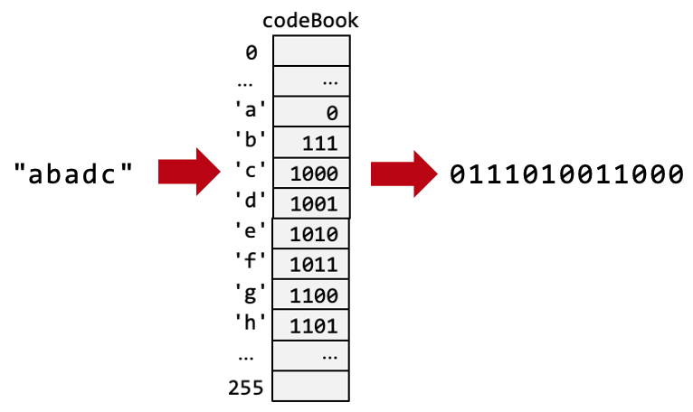
Compression class: Compressing
import java.util.LinkedList;
public class Comp {
static Node root; // top node
static String[] codeBook; // array of character codes
/** Initializes data structures, based on the given letter frequencies. */
public static void init(double[] freq) {
// Sets root to the Huffman tree
root = buildTree(freq);
// Builds and populates the code book
codeBook = new String[freq.length];
populateCodeBook(root, "", codeBook);
}
...
/** Compresses the given text into a string of 0's and 1's. */
public static String compress(String text) {
StringBuilder codedText = new StringBuilder();
// for each character in the given text, appends its code
for (int i = 0; i < text.length(); i++) {
codedText.append(codeBook[text.charAt(i)]);
}
return codedText.toString();
}
...

Slide 70
Compression class: Decompressing
import java.util.LinkedList;
public class Comp {
static Node root; // top node
static String[] codeBook; // array of character codes
...
/** Decompresses the given coded text into the original text. */
public static String decompress(String codedText) {
StringBuilder text = new StringBuilder();
Node node = root;
for (int i = 0; i < codedText.length(); i++) {
char ch = codedText.charAt(i);
// if 0, go left; if 1, go right
if (ch == '0') {
node = node.left;
} else {
node = node.right;
}
// if leaf node, appends the character
if (node.isLeaf()) {
text.append(node.ch);
// Resets to the root, for the next sequence of 0's and 1's
node = root;
}
}
// Returns the decompressed text
return text.toString();
}
...
1010
'e'

Slide 71
Lecture plan
Trees
Compression: Algorithms
Compression: Implementation
Compression: Extensions

Slide 72
Extensions
Instead of encoding single letters (1-grams), we can encode combinations of 2 or more letters (n-grams), or complete words;
In English, the 100 most commonly used words make up 50% of the text;
The resulting tree will be much deeper, but more efficient in terms of average compression time.

Slide 73
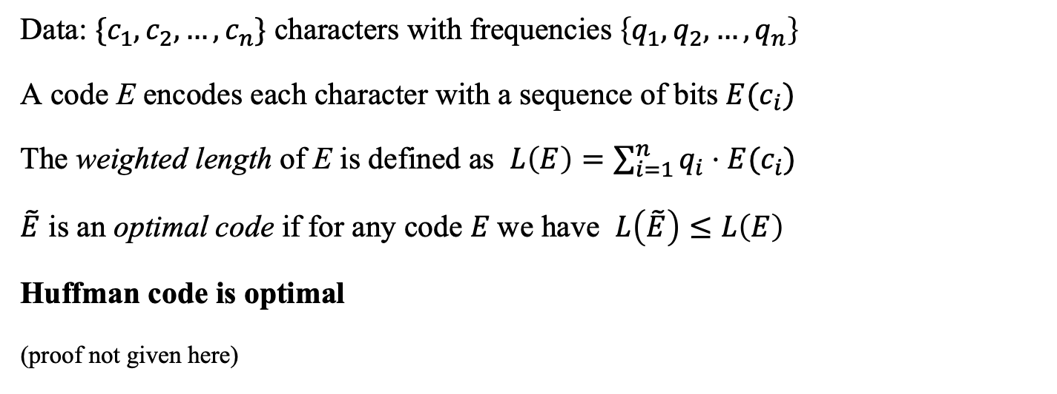
Code optimality
Data: $\{c_{1},c_{2},…,c_{n}\}$ characters with frequencies $\left\{q_{1},q_{2},…,q_{n}\right\}$
A code E encodes each character with a sequence of bits $E(c_{i})$
The weighted length of E is defined as $L\left(E\right)=\sum_{i=1}^{n}{q_{i}⋅E(c_{i})}$
$\tilde{E}$ is an optimal code if for any code $E$we have $L\left(\tilde{E}\right)≤L\left(E\right)$
Huffman code is optimal
(proof not given here)
Information theory
The study of quantifying, encoding, and transmitting information efficiently, focusing on concepts like entropy, data compression, and error correction.

Slide 74
Applications
Huffman coding is widely used in practice
File compression: zip / gzip (uses Huffman + LZ algorithm)
Multimedia: JPEG (0.2 compression ratio), MP3 (0.1), MPEG (0.01)
Communications systems
Sensors with limited memory
DNA / protein coding
Decision trees
...

Slide 75
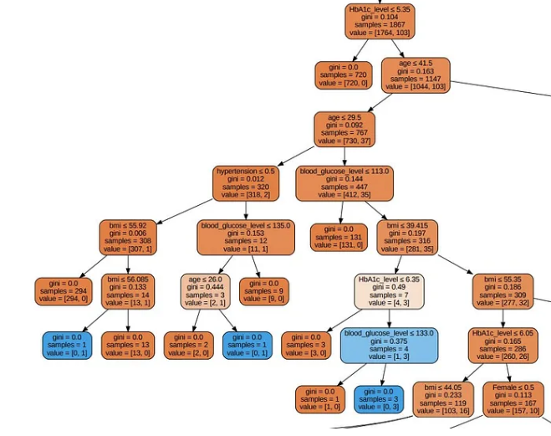
Example: Decision trees
Used in many AI systems
Example: Medical diagnosis
Some diagnoses are common, other are rare
Huffman coding is used to assign shorter codes (tree paths) to common diagnoses
Result: Shorter tree lookup (better decision time).

Slide 76

Compression
Introduction to Computer Science
Yoav Ram
IDC Herzliya
Lecture 10-1

Slide 77
Lossless compression
Compression scheme has two elements: Encoder E and Decoder D
E represents the compression if for data x we have size(E(x)) < size(x)
If the compression (E, D) is lossless then we can reconstruct every data x:
For every x, if y = E(x) then D(y) = x
If this doesn’t hold then (E, D) is called lossy.

Slide 78
Lossless vs lossy compression
If the audience cannot tell the difference between x and D(E(x)), then lossy compression may be a good choice.
Text usually requires lossless compression
Other data can be compressed with lossless compression:
Audio: MP3, ~0.1 compression ratio
Image: JPEG, ~0.2 compression ratio
Video: MPEG4, ~0.01 compression ratio

Slide 79
Universal lossless compression
the compression is lossless and universal if:
Lossless: for every x, if y = E(x) then D(y) = x
Universal: for every x, size(E(x)) < size(x)
Proposition: There is no universal lossless compression.
Proof with the Pigeonhole principle
We can concentrate on compression of typical inputs rather than any input.

Slide 80
Prefix free code
Code 1: fixed length → prefix free
Code 2: variable length & prefix free
Code 3: variable length & not prefix free
a | b | c | d | e | f
000 | 001 | 010 | 011 | 100 | 101
a | b | c | d | e | f
0 | 10 | 110 | 1110 | 11110 | 111110
a | b | c | d | e | f
0 | 1 | 00 | 01 | 10 | 11

Slide 81
Decompression
a , 8
b , 3
c , 1
d , 1
e , 1
f , 1
g , 1
h , 1

Slide 82
Huffman code
0
1
a
8
0
1
0
1
0
1
b
3
0
1
0
1
0
1
c
1
d
1
e
1
f
1
g
1
h
1

Slide 83
Decompression
0
1
a
0
1
0
1
0
1
b
0
1
0
1
0
1
c
d
e
f
g
h

Slide 84
Decompression
0
1
a
0
1
0
1
0
1
b
0
1
0
1
0
1
c
d
e
f
g
h

Slide 85
Decompression
1010
"e"

Slide 86
Compression
a
8
b
3
c
1
d
1
e
1
...
a
8
b
3
e
1
...
cd
2
c
1
d
1

Slide 87
Compression
0
1
a
0
1
0
1
0
1
b
0
1
0
1
0
1
c
d
e
f
g
h

Slide 88
Compression
0
1
a
0
1
0
1
0
1
b
0
1
0
1
0
1
c
d
e
f
g
h

Slide 89
Compression
0
1
a 8
0
1
0
1
0
1
b 3
0
1
0
1
0
1
c 1
d 1
e 1
f 1
g 1
h 1

Slide 90
Compression
0
1
a 8
0
1
0
1
0
1
b 3
0
1
0
1
0
1
c 1
d 1
e 1
f 1
g 1
h 1

Slide 91
bla
freq
0
...
...
61
8
'a'
62
3
'b'
63
1
'c'
64
1
'd'
65
1
'e'
66
1
'f'
67
1
'g'
68
1
'h'
...
...
255
freq
codeBook
0
0
...
...
...
corpus analysis
...
'a'
8
'a'
'b'
3
buildTree
buildCodes
0
'c'
'b'
111
1
'c'
1000
'd'
1
'd'
'e'
1
1001
'f'
'e'
1010
1
'f'
1011
'g'
1
'g'
'h'
1
1100
...
'h'
1101
...
...
...
255
255

Slide 92
Using the Compression class
/** Provides text compression and decompression methods.
* Before using, call the init method. */
public class Comp {
/** Initializes data structures, based on the given letter frequencies. */
public static void init(double[] freq)
/** Returns the compressed text as a string of 0 and 1 bits */
public static String compress(String text)
/** Returns the string of characters which is coded by the given * string of 0 and 1 bits */
public static String decompress(String compressed) {
}
Client code example
// Builds a frequencies array, for testing (instead of reading a file and doing corpus analysis)
double[] freq = new double[256];
freq['a'] = 8; freq['b'] = 3; freq['c'] = 1; freq['d'] = 1;
freq['e'] = 1; freq['f'] = 1; freq['g'] = 1; freq['h'] = 1;
Comp.init(freq);
String text = "abadcab";
System.out.println("Text: " + text);
String compressedText = Comp.compress(text);
System.out.println("Compressed text: " + compressedText);
System.out.println("Decompressed text: " + Comp.decompress(compressedText));
Output
Text: abadcab
Compressed text: 01110100110000111
Decompressed text: abadcab

Slide 93
Tree implementation
root
ch
freq
left
right
15
ch
freq
left
right
ch
freq
left
right
e
13
null
null
k
2
null
null

